Slide 1
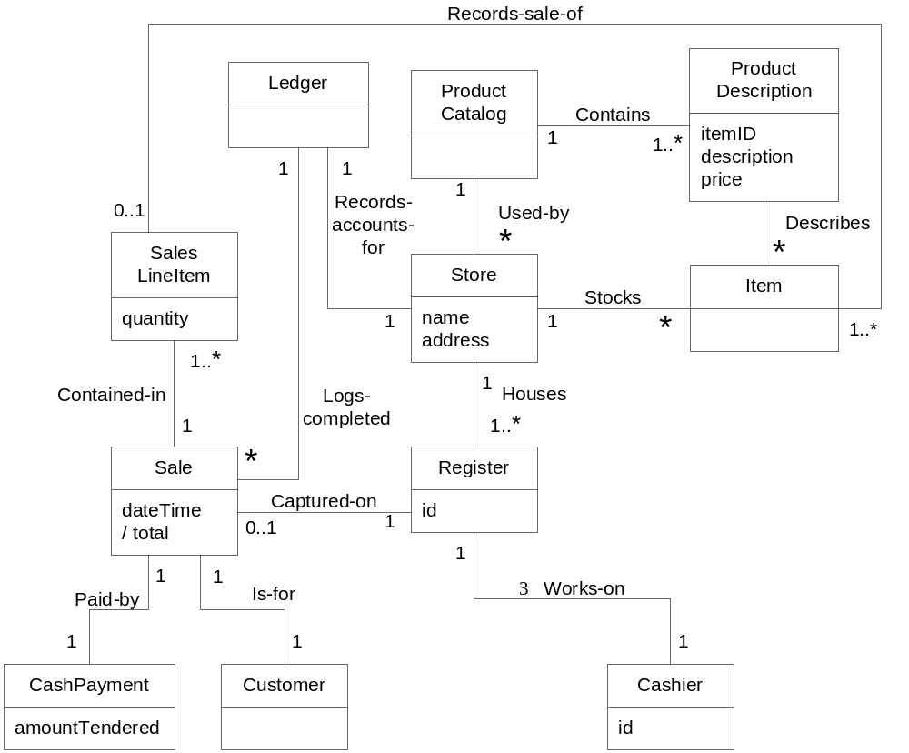
POS Partial Domain Model

Slide 2
Is the Domain Model correct?
There is no such thing as single correct domain model
All models are approximation of the domain we are attempting to understand
It is a tool for understanding the concept, terminology & relationship
Used for communicating among a particular group.

Slide 3
2.3 Representation of system behavior

Slide 4
Iteration 1-Inception
First real development iteration.
The requirement work done during inception phase was to decide if the project was worth more serious investigation.
Before starting iteration 1 design work, further investigation of the problem domain is useful such as clarification of the input and output system events, related to the system.

Slide 5
Class diagrams represent static relationships.
What about modeling dynamic behavior?
Interaction diagrams model how groups of object collaborate to perform some behavior
  Typically captures the behavior of a single use case.

Slide 6
System Sequence Diagram
Definition :
A system sequence diagram is a fast & easily created artifacts that illustrates input & output events related to the system under discussion.

Slide 7
SSD versus Sequence Diagram
System Sequence Diagrams are typically associated with use-case realization in the logical view of system development.
Sequence Diagrams (Not System Sequence Diagrams) display object interactions arranged in time sequence.

Slide 8
Sequence Diagrams
Sequence Diagrams depict the objects and classes involved in the scenario and the sequence of messages exchanged between the objects needed to carry out the functionality of the system.
Sequence diagrams can be used to drive out testable user interface requirements.

Slide 9
SSD—System Behavior
System behaves as “Black Box”.
Interior objects are not shown, as they would be on a Sequence Diagram.
:System

Slide 10
System Sequence Diagrams
Use cases describe-
How actors interact with system.
Typical course of events that external actors generate and
The order of the events.

Slide 11
System Sequence
Diagrams(2)
For a particular scenario of use-case an SSD shows-
The external actors that interact directly with the system.
The System (as a black box).
The system events that the actors generate.

Slide 12
System Sequence
Diagrams(3)
The operations of the system in response to the events generated.
System Sequence Diagrams depict the temporal order of the events.
System Sequence Diagrams should be done for the main success scenario of the use-case, and frequent and alternative scenarios.

Slide 13
Notation
Object: Objects are instances of classes. Object is represented as a rectangle which contains the name of the object underlined.
Because the system is instantiated, it is shown as an object.
:Object1

Slide 14
Notation (2)
Actor: An Actor is modeled using the ubiquitous symbol, the stick figure.
actor1

Slide 15
Notation (3)
Lifeline: The LifeLine identifies the existence of the object over time. The notation for a Lifeline is a vertical dotted line extending from an object.

Slide 16
Notation (4)
Message: Messages, modeled as horizontal arrows between Activations, indicate the communications between objects.
messageName(argument)

Slide 17
Example of an SSD
Following example shows the success scenario of the Process Sale use case.
Events generated by cashier (actor)-
makeNewSale
      enterItem
      endSale and
      makePayment.

Slide 18
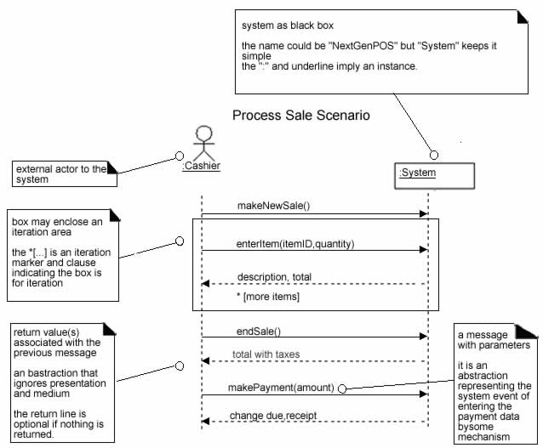
SSD for Process Sale scenario

Slide 19
System Sequence Diagrams and Use Cases
System Sequence Diagram is generated from inspection of a use case.
Constructing a systems sequence diagram from a use case-
1.Draw a line representing the system as a black box.
2.Identify each actor that directly operates on the system. Draw a line for each such actor.

Slide 20
System Sequence Diagrams and Use Cases
3.From the use case, typical course of events text, identify the system (external) events that each actor generates. They will correspond to an entry in the right hand side of the typical use case. Illustrate them on the diagram.
4.Optionally, include the use case text to the left of the diagram.

Slide 21
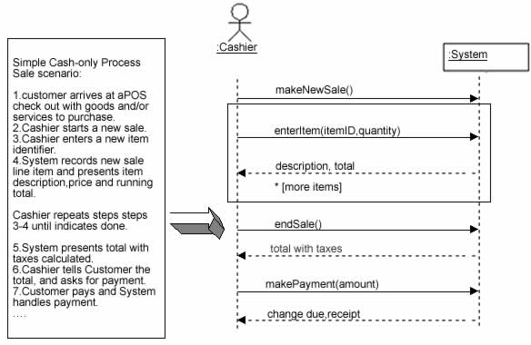
SSDs are derived from use cases.

Slide 22
System Events and System Boundary
To identify the system events, system boundary is critical.
For the purpose of software development, the system boundary is chosen to be the software system itself.

Slide 23
System Events and System Boundary(2)
Identifying the System events-
Determine the actors that directly interact with the system.
In the process Sale example, the customer does not directly interact with the POS system. Cashier interacts with the system directly. Therefore cashier is the generator of the system events.

Slide 24
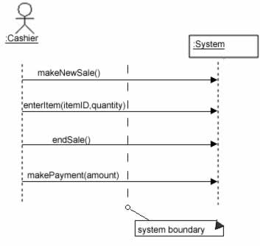
Defining system boundary.

Slide 25
Naming System Events and Operations
System event
External input event generated by an actor.
Initiates a responding operation by system.
System operation
Operation invoked in response to system event.

Slide 26
Naming System Events and Operations(2)
System events and their associated system operations should be expressed at the level of intent rather than in terms of the physical input medium or widget.
In order to improve the clarity, it is appropriate to start the name of the system event with a verb (for example- add….,enter….,end….,make…. etc.,). It also emphasizes the command origination of these events.

Slide 27
Naming System Events and Operations(3)
For example “enterItem” is better than “scan” as it captures the intent of operation rather than what interface is used to capture the system event (design choice).

Slide 28
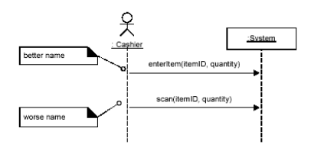
Choose event and operation names at an abstract level

Slide 29
Showing Use Case Text
It is desirable to show at least fragments of use case text for the scenario.
The text provides the details and context, while the diagram visually summarizes the interaction.

Slide 30
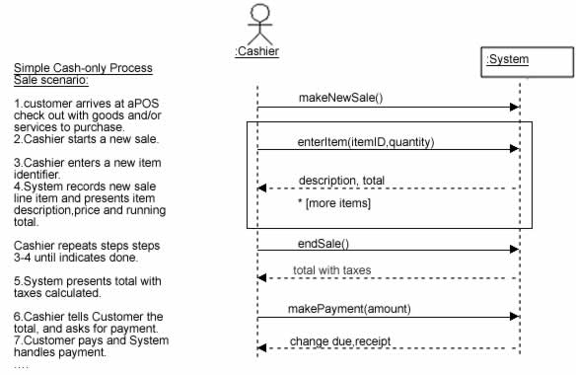
SSD with use case text

Slide 31
Simple Cash only Process Sale Scenario
1.Customer arrives at a POS checkout with goods and or services to purchase
2.Cashier starts a new sale
3.Cashier enters item identifier
4.System records sale line item and presents item description , price and running total Cashier repeats steps 3-4 times until indicates done
5.System presents total with taxes calculated
6.Cashier tells customer the total and asks for payment
7.Customer pays and system handles payment

Slide 32
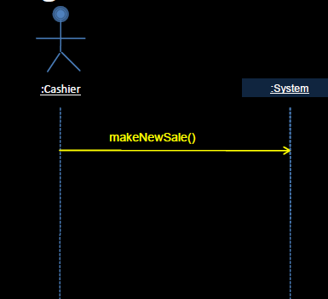
Simple Cash only Process Sale Scenario

Slide 33
Simple Cash only Process Sale Scenario
Simple Cash only Process Sale Scenario
1.Customer arrives at a POS checkout with goods and or services to purchase
2.Cashier starts a new sale
3.Cashier enters item identifier
4.System records sale line item and presents item description , price and running total Cashier repeats steps 3-4 times until indicates done
5.System presents total with taxes calculated
6.Cashier tells customer the total and asks for payment
7.Customer pays and system handles payment

Slide 34
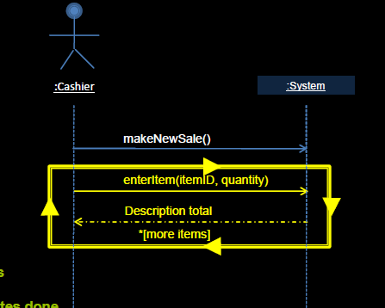
Simple Cash only Process Sale Scenario

Slide 35
Simple Cash only Process Sale Scenario
Simple Cash only Process Sale Scenario
1.Customer arrives at a POS checkout with goods and or services to purchase
2.Cashier starts a new sale
3.Cashier enters item identifier
4.System records sale line item and presents item description , price and running total Cashier repeats steps 3-4 times until indicates done
5.System presents total with taxes calculated
6.Cashier tells customer the total, asks for payment
7.Customer pays and system handles payment

Slide 36
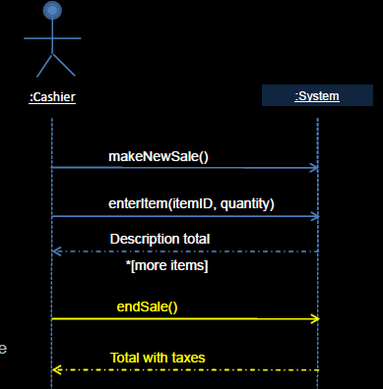
Simple Cash only Process Sale Scenario

Slide 37
Simple Cash only Process Sale Scenario
1.Customer arrives at a POS checkout with goods and or services to purchase
2.Cashier starts a new sale
3.Cashier enters item identifier
4.System records sale line item and presents item description , price and running total Cashier repeats steps 3-4 times until indicates done
5.System presents total with taxes calculated
6.Cashier tells customer the total and asks for payment
7.Customer pays and system handles payment

Slide 38
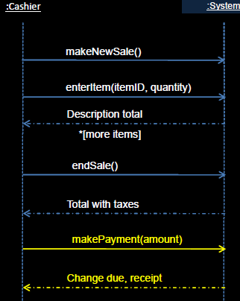
Simple Cash only Process Sale Scenario

Slide 39
Naming System Events and Operations
System events (and their associated system operations) should be expressed at the level of intent rather than in terms of the physical input medium or interface widget level.
It also improves clarity to start the name of a system event with a verb(add..., enter..., end..., make...), as in since it emphasizes the command orientation of these events.

Slide 40
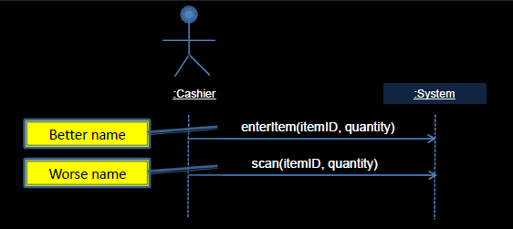
Naming System Events and Operations

Slide 41
SSD and the Glossary
Since the terms used in SSDs are terse, they may need proper explanation. If these terms are not explained in use cases, glossary could be used.
A glossary is less formal, it is easier to maintain and more intuitive to discuss with external parties such as users and customers.
However, glossary data should be meaningful, otherwise it will be an unnecessary work.

Slide 42
System Sequence Diagrams Within the Unified Process
System Sequence Diagrams are a visualization of the interactions implied in the use cases.
System Sequence Diagrams were not explicitly mentioned in the original UP description.
Phases
1.Inception: System Sequence Diagrams are not usually motivated in inception.

Slide 43
System Sequence Diagrams Within the Unified Process
Elaboration: It is useful to create System Sequence Diagrams during elaboration in order to -
Identify the system events and major operations.
To write system operation contracts (Contracts describe detailed system behavior) and
To support estimation.

Slide 44
Operation Contracts
Use cases are the primary mechanism in the UP to describe system behavior, and are usually sufficient.
However, sometimes a more detailed description of system behavior has value.
Contracts for operations can help define system behavior.
A Domain Model
A visual representation of conceptual classes or real-world objects in a domain of interest.
Contracts
A detailed system behavior in terms of state changes to objects in the Domain Model, after a system operation has executed.

Slide 45
Operation Contracts
Operation: Name of operation, and parameters.
Cross References: Use cases this can occur within. (optional)
Preconditions: Noteworthy assumptions about the state of the system or objects in the Domain Model before execution of the operation.
Post conditions: The state of objects in the Domain Model after completion of the operation

Slide 46
Operation Contracts
Post conditions are not actions to be performed, during the operation; rather, they are declarations about the Domain Model objects that are true when the operation has finished. after the smoke has cleared.
Express post conditions in the past tense, to emphasize they are declarations about a state change in the past.
(better) A SalesLineItem was created.
(worse) Create a SalesLineItem.

Slide 47
Contract CO2: enterItem
Operation: enterItem(itemID : ItemID,quantity : integer)
Cross References: Use Cases: Process
SalePreconditions:There is a Sale Underway.
Postconditions:A SalesLineItem instance sli was created (instance creation)-sli was associated with thecurrent Sale (association formed)-sli.quantity became quantity(attribute modification)-sli was associated with aProductSpecification, based onitemID match (association formed)

Slide 48
Example-SSD-Student enrolling in a University

Slide 49
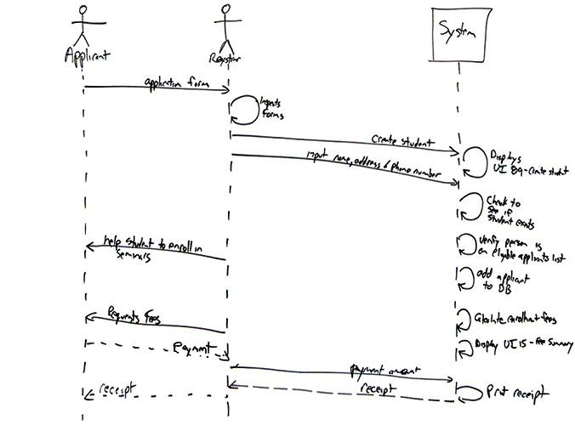


Slide 50
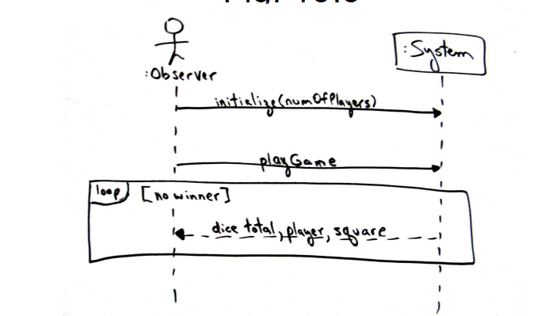
Example 2-Dice Game

Slide 51
System Sequence Diagrams Within the Unified Process
Elaboration: It is useful to create System Sequence Diagrams during elaboration in order to -
Identify the system events and major operations.
To write system operation contracts (Contracts describe detailed system behavior) and
To support estimation.

Slide 52
Conclusion
System Sequence Diagrams provide a way for us to visually step through invocation of the operations defined by Use-Cases.
It is not necessary to create SSDs for all scenarios of all use-cases,at least not at the same time.

